Slide 1







Overview of Recommender System

Slide 2

Content
1，Overview of Recommender Algorithms
Collaborative Filtering
Content-based Filtering
Hybrid Approaches
Popularity
Advanced or “Non-traditional” Approaches
2，Details of Recommender Algorithms
User-based CF
Item-based CF
Matrix Factorisation
3，Practical Recommender System in YHD
See and See
People who similar to you have bought
Recsys Based on UserProfile

Slide 3
Overview of Recommender Algorithms
Collaborative Filtering
Collaborative filtering looks for patterns in the user activity to produce user specific recommendations
Usage data
Types
Pros and Cons
User Activity
Neighborhood-based CF
Model-based CF
Pros:
User and Item features are not need
Produces good enough results in most
cases
Cons:
Cold Start problem
Need standardized products
can’t play well with the long tail
can’t be difficult to provide explanations
ratings
purchases
downloads
user preference
User-based, item-based
Matrix Factorisation
Restricted Boltzmann Machines
Bayesian Networks

Slide 4
Overview of Recommender Algorithms
Content-based Filtering
Content-based Filtering recommends items with similar content (metadata, topics, description)
Data
Tools
Pros and Cons
the content/descriptions of items and users
Information Retrieval
Machine Learning(NB,SVm,DT)
Pros:
No cold start problem
No need for usage data
No prefer to popularity product
Can provide explanations
Cons:
Item need to be machine readable
and meaningful
Difficult to combine multiple item’s
features together
brand:apple
RAM: 16g
ssd: 256g
Screen: retina

Slide 5
Overview of Recommender Algorithms
Hybrid Approaches
Hybrid Approaches combines CF and CB in order to use the pros of one to address the cons of the other
Data
Tools
Pros and Cons
Usage data
and user and item content features
Weighted
Rules
Feature Combination
Cascade
Feature augmentation
Pros:
Often outperforms CF and CB alone
No cold start problem
No prefer to the popularity products
Diversity
Cons:
Be harder to get balance
brand:apple
RAM: 16g
ssd: 256g
Screen: retina
&& Action Data
Recommender Based on UserProfile

Slide 6
Overview of Recommender Algorithms
POPULARITY
Hybrid Approaches combines CF and CB in order to use the pros of one to address the cons of the other
Data
Pros and Cons
Usage data and item content（categories）
Pros:
Relatively easy to implement
Good baseline algorithm
Helps with new user cold start
problem
Cons:
Need standardized products
Fewer opportunities to learn
Recommendation list not to change
Recommender Based on UserProfile

Slide 7
Overview of Recommender Algorithms
Advanced or “Non-traditional” Approaches
Hybrid Approaches combines CF and CB in order to use the pros of one to address the cons of the other
Pros and Cons
Pros:
Deep Learning
Learning to Rank
Social Recommendations
problem
Pros:
I don’t know, Maybe Good performance
Cons:
Less Understood
Less supported in Open source Recommendation
toolkits

Slide 8
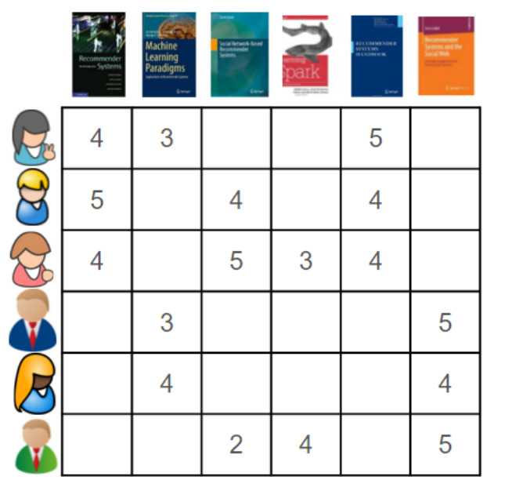
Details of Recommender Algorithms
Collaborative Filtering
Usage Data

Slide 9
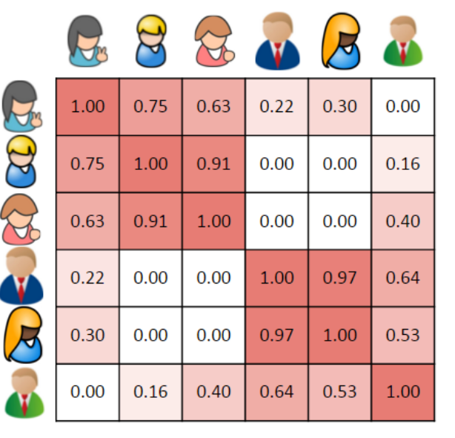
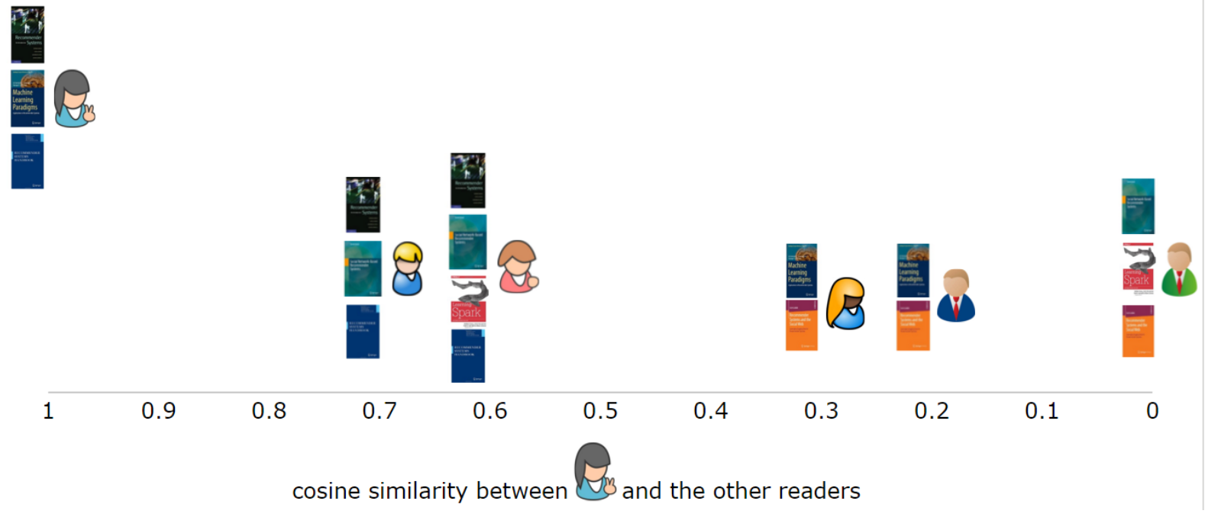
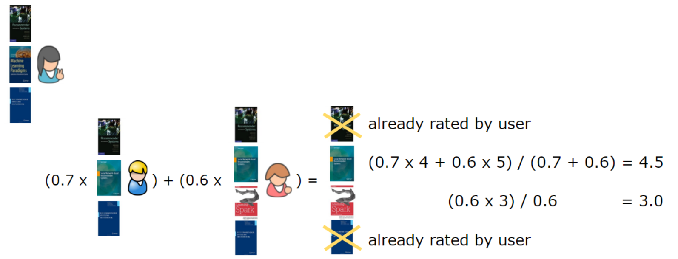
Details of Recommender Algorithms
User-Based CF

Slide 10
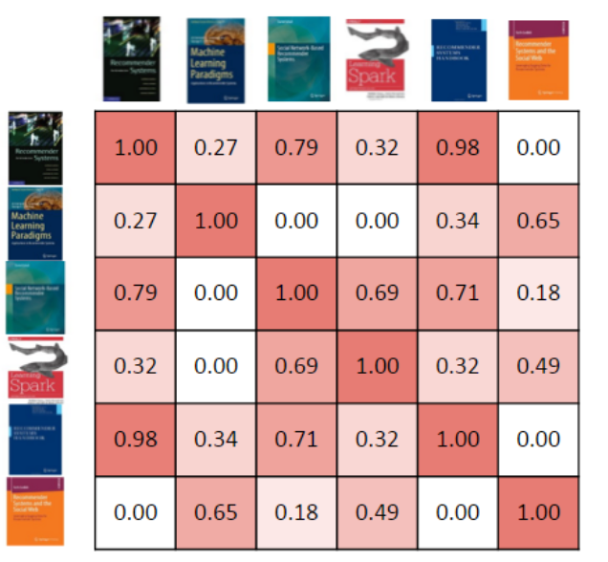
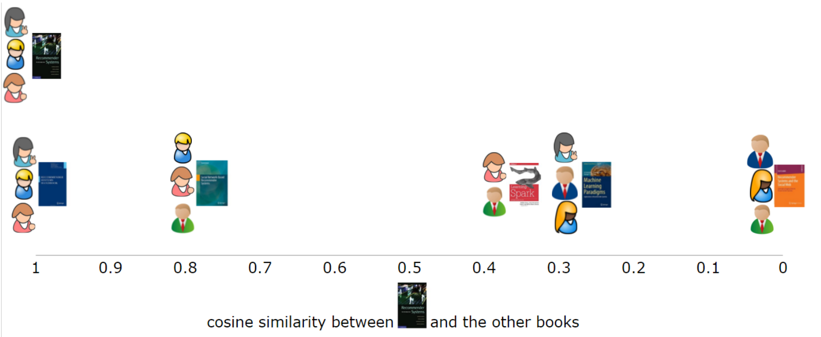
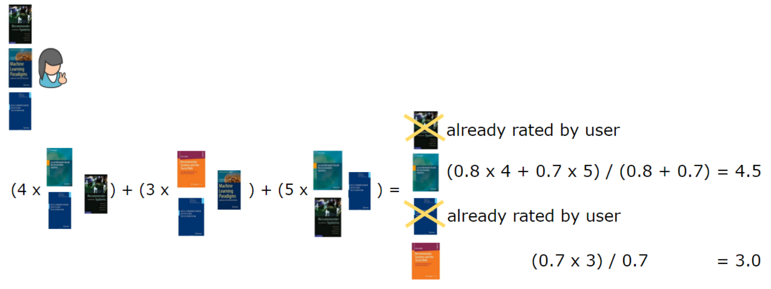
Details of Recommender Algorithms
Item-Based CF

Slide 11
Details of Recommender Algorithms
Matrix Factorisation
Big and Sparse

Slide 12
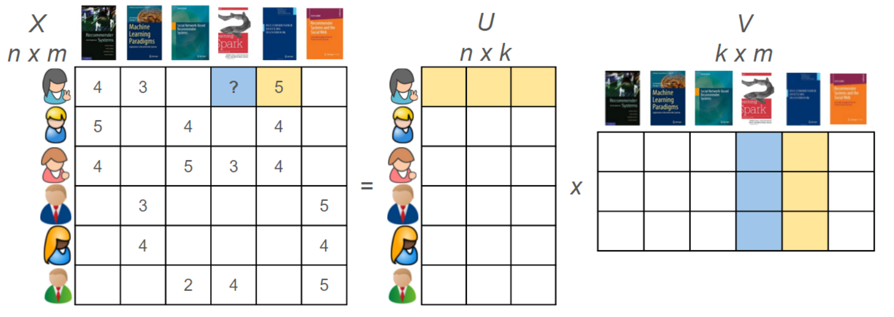
Details of Recommender Algorithms
Matrix Factorisation
http://hacker.duanshishi.com/?p=1345

Slide 13
Practical Recommender System in YHD
See and See
Item-Based CF:
session id and gen the Big item Matrix(100w*100w)
Reservoir Samplin
(100w*100w==>100w*p*100w)

Slide 14
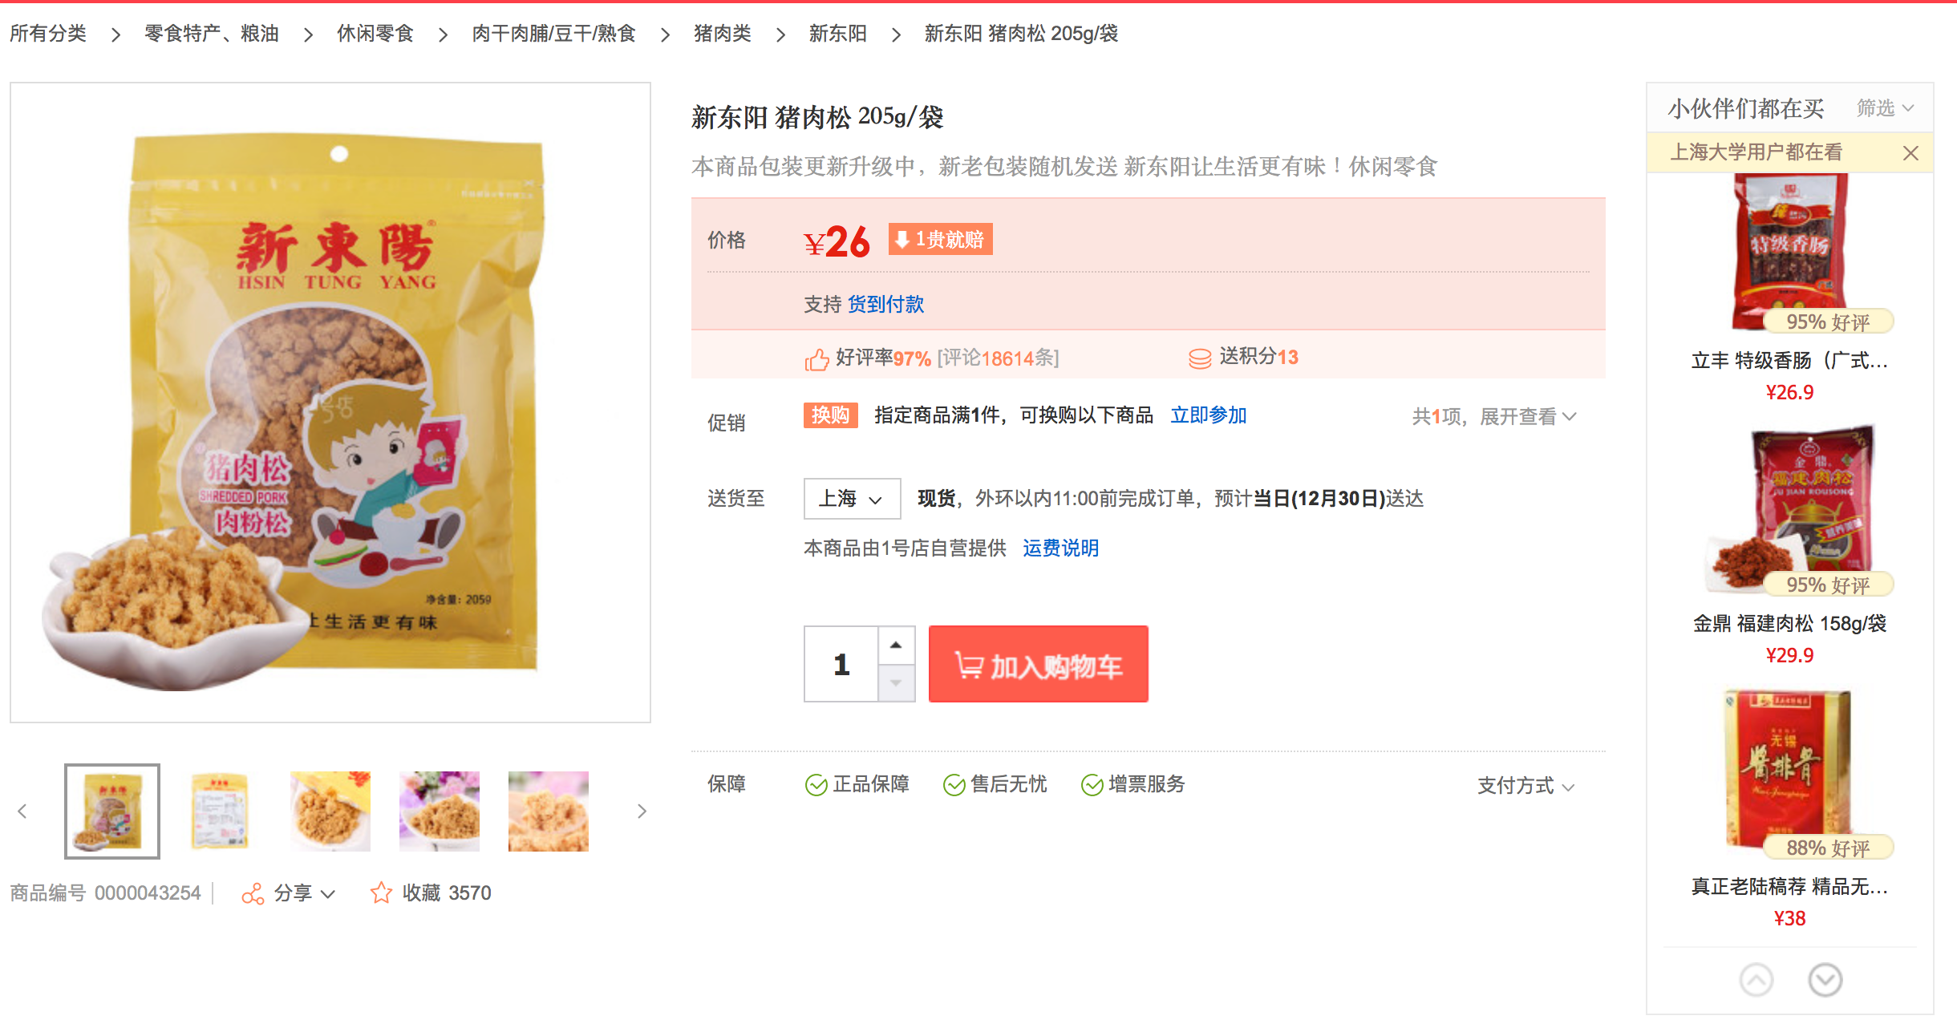
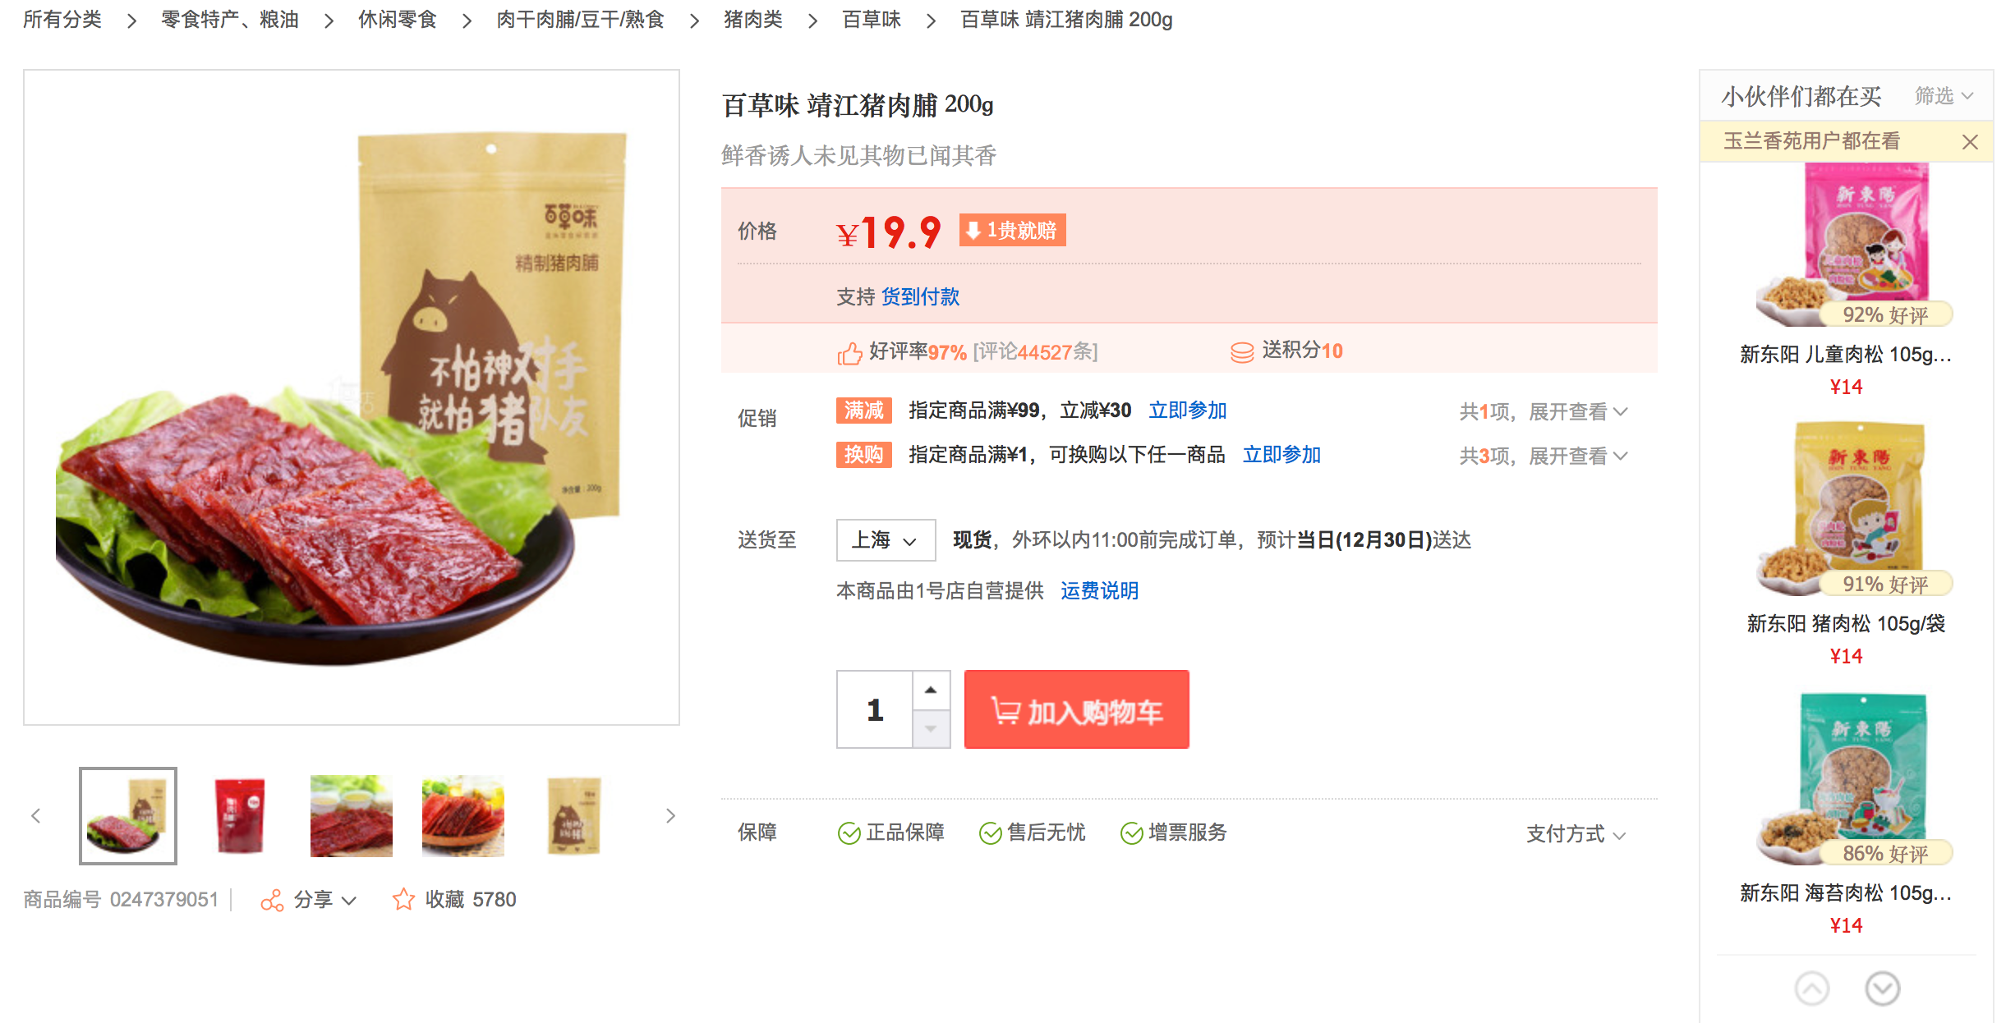
Practical Recommender System in YHD
People who similar to you have bought
Mining The User Labels With the Campus and housing estate
Stat the Order info the User with the same campus or housing estate
Use these Order things to recommend under the same category

Slide 15
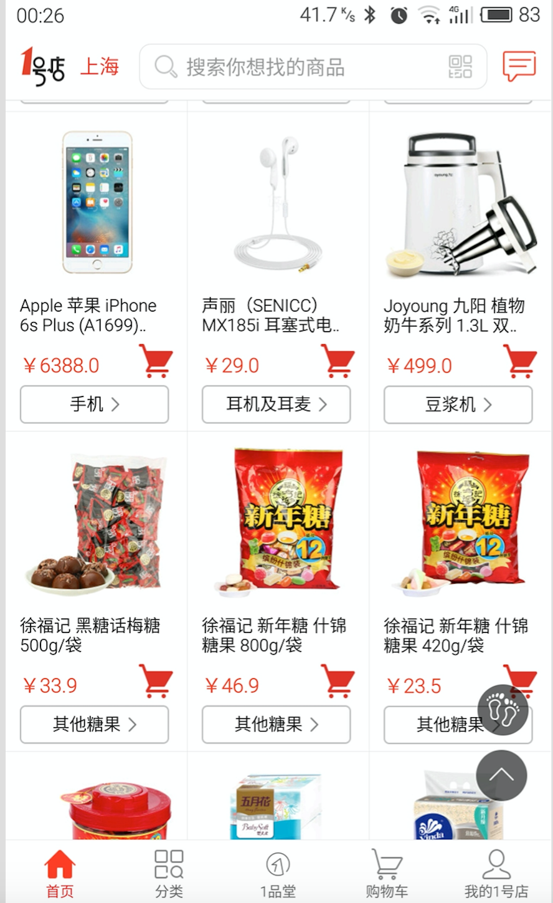
Practical Recommender System in YHD
Recsys Based on UserProfile
Mining your pref data about the attribute of the items from the all action info on YHD(app and PC),such as brand, size etc
Recommend to you the items under your fav attributes with some limit with the category
Future:
1，we will range the items based on your pref with the attribute on more filed；
2，Mix UserProfile with Other rec algorithms；
3，Maybe More…

Slide 16
PMS Other Algorithms
Association Rules
http://hacker.duanshishi.com/?p=55
Sales forecast
User Labels Mining
Intention
……
User Value Model

Slide 17
谢谢
https://github.com/burness?tab=repositories
http://hacker.duanshishi.com

